Slide 1
Puppet
Configuration Management Made Eas(ier)

Slide 2
Introduction
Aaron Bernstein – Aspiring Engineer
One of the lead developers in the Workspace Team at GoDaddy
Been working with GoDaddy for about a year and a half.
Specifically tasked on our FaxThruEmail product.
Experience includes:
Fifteen years of programming in a multitude of languages…
Responsible for system administration over the last decade.
Currently working with operations/engineering on:
Automating our configuration and package management (RPM/YUM, Puppet);
Improving our build (deploy) process (Jenkins, Spacewalk, Koji/Sake);
Implementing continuous integration efforts for our product (Github, Unit Testing).

Slide 3
Presentation Styles & disclaimers
Bold = Keywords
Italicized = Applicable Terms
Courier = Code Samples
Green = GoDaddy
Underlined = Links
!! All contents within this presentation have come from open sources, all credit goes to those who created it. I have merely become a messenger of the knowledge. It’s open source, pass it around !!
The MIT License (MIT)
Copyright (c) 2013 Aaron Bernstein
Permission is hereby granted, free of charge, to any person obtaining a copy of this presentation and associated documentation files (the “Presentation"), to deal in the Presentation without restriction, including without limitation the rights to use, copy, modify, merge, publish, distribute, sublicense, and/or sell copies of the Presentation, and to permit persons to whom the Presentation is furnished to do so, subject to the following conditions:
The above copyright notice and this permission notice shall be included in all copies or substantial portions of the Presentation.
THE PRESENTATION IS PROVIDED "AS IS", WITHOUT WARRANTY OF ANY KIND, EXPRESS ORIMPLIED, INCLUDING BUT NOT LIMITED TO THE WARRANTIES OF MERCHANTABILITY, FITNESS FOR A PARTICULAR PURPOSE AND NONINFRINGEMENT. IN NO EVENT SHALL THE AUTHORS OR COPYRIGHT HOLDERS BE LIABLE FOR ANY CLAIM, DAMAGES OR OTHER LIABILITY, WHETHER IN AN ACTION OF CONTRACT, TORT OR OTHERWISE, ARISING FROM, OUT OF OR INCONNECTION WITH THE PRESENTATION OR THE USE OR OTHER DEALINGS IN THE PRESENTATION.

Slide 4

Surface level - Conceptual

Slide 5
Our Product and Services
Servers
Operating Systems
Packages
Languages
Product
We manage a complex set of components that interlink to provide our FaxThruEmail product.
Hardware
Bare Metal and VMWare
Server Types
Application, Database, DocConverters, Fax, Web
Operating Systems
Centos 5 & 6 and Windows 8 64bit
Packages
Admin and Customer User Interfaces
API to link Application to Consumers
Legal, front-of-site, web and admin
Dependent Libraries, Frameworks, and Services
Languages
C++, C#, Java, Perl, Bash, PHP, xHTML, CSS, Javascript, etc…

Slide 6
Symbiosis Between Departments
Software Development
Operations
Quality Assurance
Engineering
Resource Management
Project Development
Notes:
Definitions:
Symbiosis is a cooperative relationship, as between two persons or groups.

Slide 7

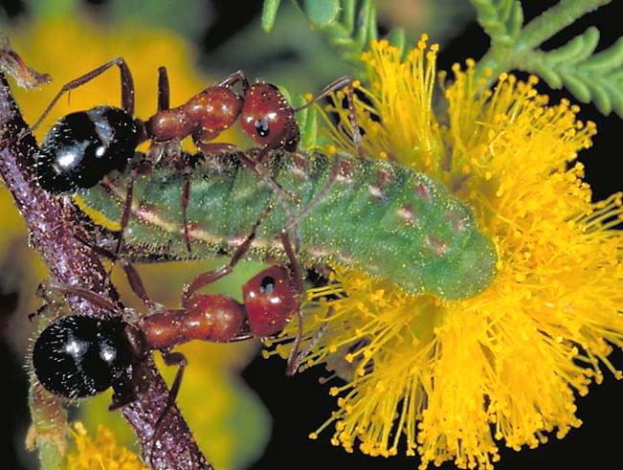
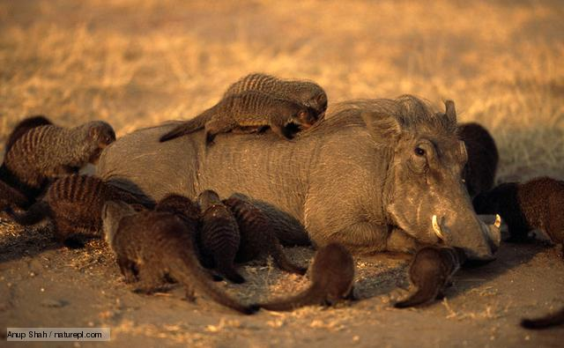

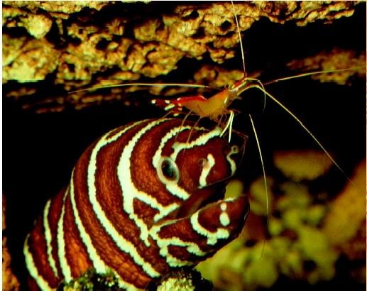



Symbiosis In The Natural World

Slide 8
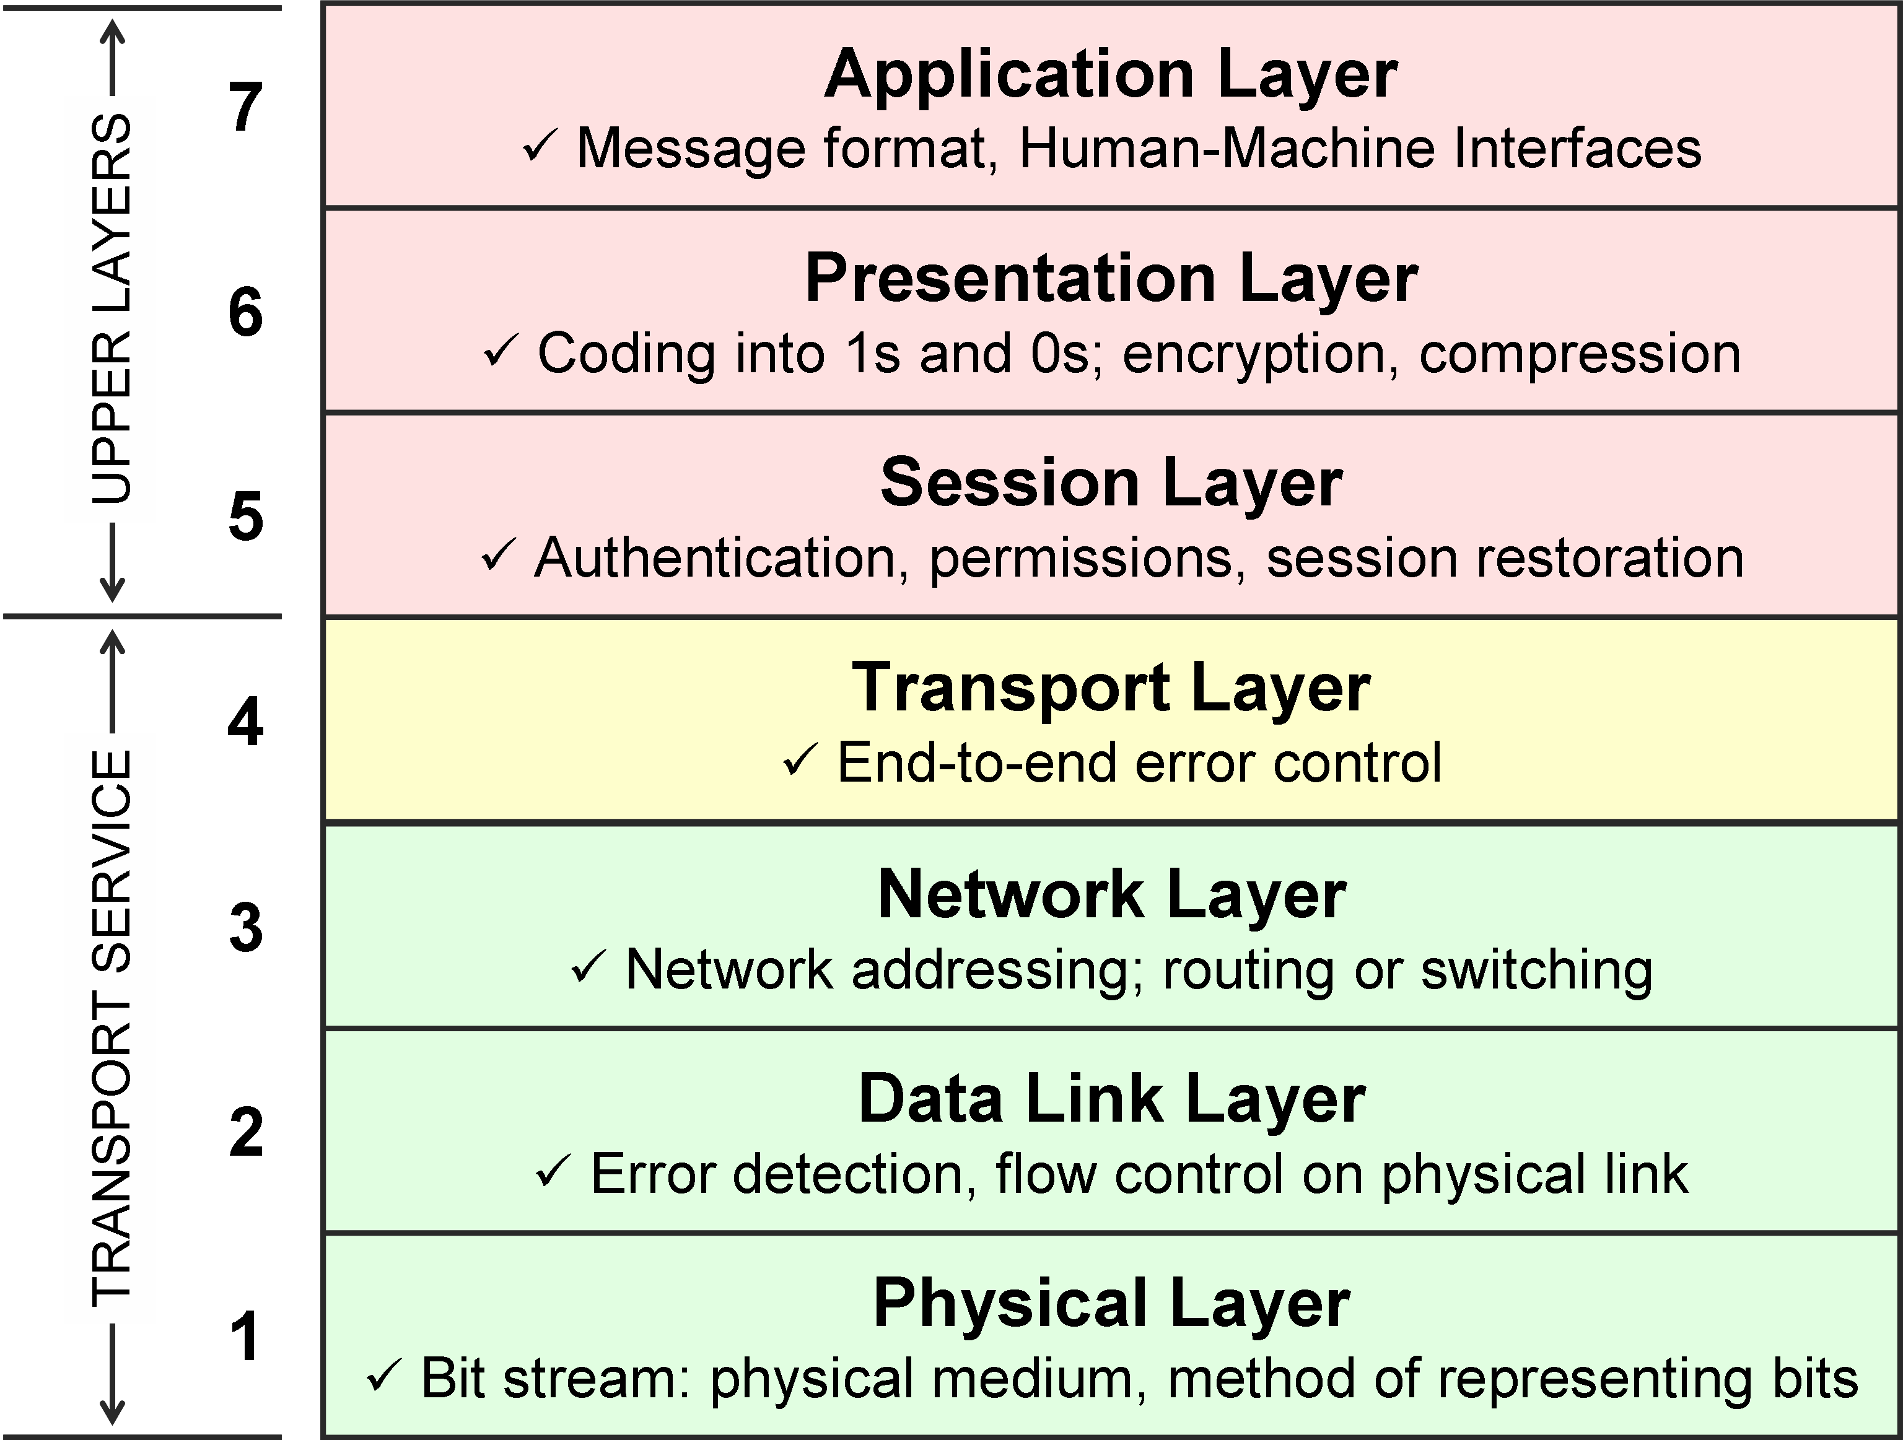
Happiness Scale Based on The OSI Model Responsibilities
Happiness

Slide 9
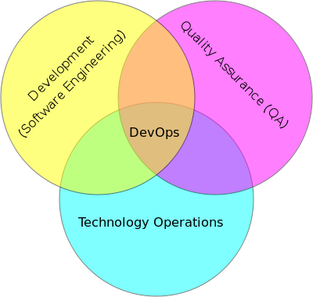
Synergy Between Departments
http://en.wikipedia.org/wiki/DevOps
Notes:
Definitions:
Synergy the interaction or cooperation of two or more organizations to produce a combined effect greater than the sum of their separate effects.
Devops is a software development method that stresses communication, collaboration and integration between software developers and IT professionals.
Supporting Notes:
To improve reliability, security, faster development and deployment cycles, DevOps integration:
targets product delivery, quality testing, feature development, and maintenance releases
Many of the ideas (and people) involved in DevOps came from the Enterprise Systems Management and Agile software development movements.

Slide 10
System Administration Eco-System
In order to understand something, one should be able to see it in both abstract and concrete terms.
En Abstracto
Dispatch Arbitrary Commands
Build System Packages
Package Specifications
Manage System Libraries
Language Specific Dependency Management
Automate Jobs
Manage Configuration
En Concreto
Spacewalk
Koji
Sake
RPM, Aptitude, Apt-Get, Yum, DLL, Etc.
Puppet
Composer, NPM, Bundler, Etc.
Jenkins
Notes:
Definitions:
Eco-System is a complex network or interconnected system.

Slide 11
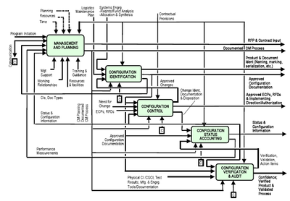
What is Configuration Management?
The practice of handling changes systematically so that a system maintains its integrity over time.
Implements the policies, procedures, techniques, and tools that are required to:
Manage, evaluate proposed changes, track the status of changes, and to maintain an inventory of system and support documents as the system changes.
Programs and plans provide technical and administrative direction to the development and implementation of the procedures, functions, services, tools, processes, and resources required to successfully develop and support a complex system.
During system development, it allows program management to track requirements throughout the life cycle through acceptance, operations, and maintenance.
As changes are inevitably made to the requirements and design, they must be approved and documented, creating an accurate record of the system status.
Ideally the process is applied throughout the system lifecycle.

Slide 12

What is Puppet?
An open source framework and toolset for managing the configuration of computer systems.
Ruby-based, licensed as GPLv2
Runs in either client/server or stand-alone modes.
Can be used to manage configuration on UNIX (including OSX) and Linux platforms, and recently Microsoft Windows platforms as well.
Often used to manage a host through out it’s lifecycle:
From initial build and installation, to upgrades and maintenance, and finally to end of life.
Designed to continuously interact with your hosts unlike provisioning tools which usually build your hosts and leave them unmanaged.
Concerned about the state of your server, and works to bring the configuration into compliance.
Official Site
Workshop
Learning VM
Learning Guide
Style Guide
Glossary of Terms
Notes:
Supporting Notes:
Current stable version is 3, but we currently are writing towards 2.7.x logic. This talk covers general principles and logic, but specifically focuses on 2.7.x. This is because Puppet 3 initiative is on-going and you should be able to refactor your modules with relatively little effort. If you are using a version below 2.7.x, it is recommended to upgrade.
Workshop classes are totally free.

Slide 13





























Who Uses Puppet?

Slide 14











































Who ELSE Uses Puppet?

Slide 15
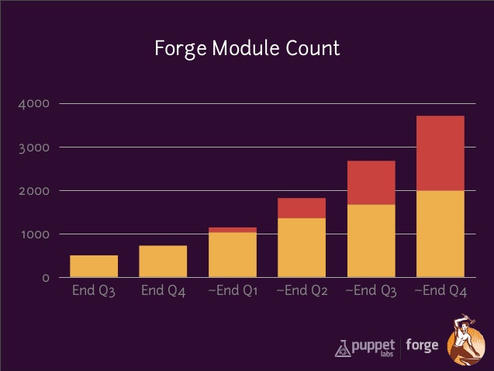
Key Benefits of Using Puppet
Ensure that all machines are up-to-date.
Apply/modify the configuration to your machines at any time.
Define all your configuration in text files.
Different distributions use different conventions, naming, locations, etc.
Supported Operating Systems:
Red Hat Enterprise Linux (RHEL) 5, 6
Windows Server 2003, 2008 & 2012, and Windows 7
CentOS 5, 6
Ubuntu 10.04 LTS & 12.04 LTS
Debian 6, 7
Scientific Linux 5, 6
Oracle Linux 5, 6
Solaris 10
AIX 5.3, 6.1, 7.1
Community driven module repository with over 3k.
AWS EC2, VMware vSphere, Openstack, Eucalyptus,RightScale, Zenoss, Tomcat, Apache, nginx, Cloudera Hadoop, Red Hat KVM, Splunk, Wordpress, NetApp, Cisco IOS, Juniper, F5, MySQL
Notes:
Important:
Teams at GoDaddy have been using Puppet and we continue to invest in it being a part of our future.

Slide 16

Seeing the Trees, Through the Forest
Notes:
Supporting Notes:
Infrastructure can be relatively complex and it only grows in complexity the more pieces you add to support your particular application(s).
However, all infrastructure configurations can be broken down into components: individual pieces that are installed, configured and monitored.
These components can be as simple as a user or a file, and as complex as multiple servers in a cluster supporting backend data.

Slide 17
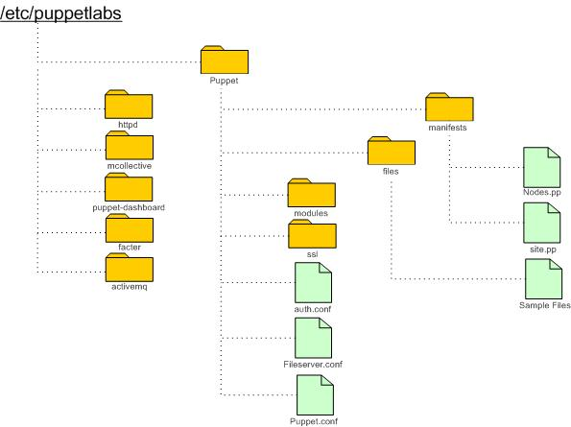
Puppet Directory structure

Slide 18
Puppet Deployment Models
Usually deployed in a simple client-server model.
Server is called the “Puppet Master”
Client is referred to as the “Agent”
Pull requests from agent to puppet master run over SSL.
If the agent has no configuration available or already has the required configuration, Puppet agent will do nothing.
Agents cache their most recent catalog. If the master fails to compile one, they will re-use their cached catalog.
Host is defined as a “Node”
The whole process is called a configuration run.
Can also run in what is referred to as “master-less”.
Where the client/server reside on the same instance.
Configuration runs by default execute every 30 minutes looking at what’s defined in `$confdir/puppet` sub-directories.
Puppet Master(s)
Agent(s)
Node(s)

Slide 19
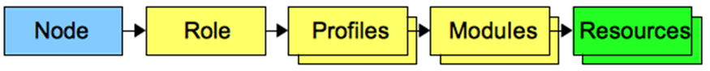
Design Pattern: Node/Role/Profiles/Modules/Resources
A node includes one role, and one only;
A role includes one or more profiles to define the type of server;
A profile includes and manages modules to define a logical technical stack;
Modules manage resources and should only be responsible for managing aspects of the component they are written for.

Slide 20
Naming Conventions
Node names should match the hostnames of the nodes.
(local.domain, smtp.myserver.com)
Roles should be named in business logic convention.
(uat_server, web_cluster, application, archive)
Profiles should be named after the logical stack they implement.
(database, bastion, web, email)
Components/Modules should be named after what they manage.
(apache, ssh, mysql, ntp)
Classes that disables ssh should be inherited from the ssh class and be named “ssh::disabled”.

Slide 21
Puppet Configuration Run Diagram
Puppet Master
Check Credentials
Agent
Send Facts
Returns “catalog”
Report Results

Slide 22
Puppet Environments
Puppet master(s)/agents can be configured using the `environment` and `modulepath` flags in the `$confdir/puppet.conf`
You can use a single Puppet master to serve multiple isolated configurations.
This allows a method to test configuration changes prior to them making it into a production cluster and wreaking havoc.
Used to isolate different sets of machines,
Changes made to the ‘web server’ environment don’t get applied to machines that don’t need that configuration.
There are four forbidden environment names:
main, master, agent, user
To set an environment agent-side,
Specify the environment setting in either the [agent] or [main] block of puppet.conf.
As with any config setting, you can also temporarily set it with a command line option.
The $environment variable should only rarely be necessary, but it’s there if you need it.
Extra Resources
Puppet Environment Caveats
# $confdir/puppet.conf [master] modulepath = $confdir/environments/$environment/modules:$confdir/modules manifest = $confdir/manifests/unknown_environment.pp [production] manifest = $confdir/manifests/site.pp [dev] manifest = $confdir/manifests/site.pp [agent] environment = dev
[root@agent ~]# puppet agent --environment dev
Notes:
Supporting Notes:
In short, environments let the master tweak its own configuration on the fly, and offer a way to completely swap out the set of available modules for certain nodes.

Slide 23
Puppet Facts & Using Facter
Uses facter to gather information about the host system.
Run `facter -p` on one of your nodes to get a complete report of the facts that node will report to the master.
All facts are strings, and all non-empty strings - including the string “false” - are true.
This means that facts that are “false” need to be transformed before Puppet will treat them as false.
Extra Resources
Complete list of built-in facts
Guide to writing custom facts
[root@agent ~]# facter –p
…
facterversion => 1.6.10
fqdn => learn.localdomain
kernel => Linux
kernelrelease => 2.6.18-274.el5
operatingsystem => CentOS
operatingsystemrelease => 5.7
osfamily => RedHat
ipaddress => 172.21.44.173
memoryfree => 315.25 MB
pe_version => 2.7.0
processor0 => Intel(R) Core(TM) i7-3520M CPU @ 2.90GHz
uptime => 3 days
…
Notes:
Supporting Notes:
Also referred to as a Puppet plugin. Located in the lib/facter

Slide 24
Puppet Configuration Run Diagram
Puppet Master
Check Credentials
Agent
Send Facts
Returns “catalog”
Report Results

Slide 25
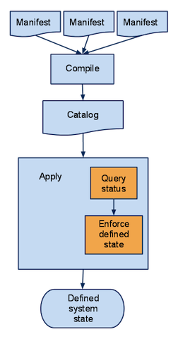
Compilation of the Catalog
Manifests are files containing code written in the Puppet language, and named with the `.pp` file extension.
The Puppet code in a manifest can:
Declare resources and classes,
Set variables,
Evaluate functions,
Define classes, defined types, and nodes.
Most manifests are contained in modules.
Every manifest in a module should define a single class or defined type.
A catalog is a compilation of all the resources that will be applied to a given system and the relationships between those resources.
Defined system state represents the desired particular condition of the agent at a specific time.
Notes:
Definitions:
Idempotence is the property of certain operations in computer science, that can be applied multiple times without changing the result beyond the initial application.

Slide 26
Puppet Manifests
Each `.pp` file should contain one and only one class or defined type.
Filenames and class/defined type names are related.
Within a module, the special $module_name variable always contains the module's name.
# apache/manifests/init.pp class apache { … }
# apache/manifests/vhost.pp define apache::vhost ($port, $docroot) { … } # apache/manifests/config/ssl.pp class apache::config::ssl { … }
Notes:
Supporting Notes:
<MODULE NAME>::<SUBDIRECTORY NAME>::<FILENAME>

Slide 27
Variables & Scope
Can hold strings, numbers, booleans, arrays, hashes, and the special undef value.
If you’ve never assigned a variable, you can actually still use it - its value will be undef.
You can also interpolate variables inside double-quoted strings.
To distinguish a variable from the surrounding text, you can wrap its name in curly braces.
"This is the ${variable} name."
This isn’t mandatory, but it is recommended.
You can only assign the same variable once in a given scope.
In this way, they’re more like constants from other programming languages.
Every variable has two names:
A short local name ($local_variable)
A long fully-qualified name ($scope::variable).
Top scope variables are the same, but their scope is nameless. (For example: $::top_scope_variable.)
What’s Changing?
If you reference a variable with its short name and it isn’t present in the local scope, Puppet will also check the global top scope; this means you can almost always refer to global variables with just their short names.
Although, in future versions dynamic scope will be removed from the Puppet language. This will be a major and backwards-incompatible change.
Currently, if an unqualified variable isn’t defined in the local scope, Puppet looks it up along an unlimited chain of parent scopes, eventually ending at top scope.
In the future, Puppet will only examine the local, inherited, node, and top scopes when resolving an unqualified variable; intervening scopes will be ignored. In effect, all variables will one of the following:
Local
Inherited from a base class
Node-level
Global
Notes:
Supporting Notes:
Variables always start with a dollar sign.
You assign to variables with the equal sign.
You can use variables as the value for any resource attribute, or as the title of a resource.

Slide 28
Design pattern: Package/File/Service
Also referred to as “THE TRIFECTA”
Learn it, live it, love it.
If you can only do this, you can still do a lot.
# Package/File/Service SSH Example package { 'openssh-server': ensure => installed, } file { '/etc/ssh/sshd_config': source => 'puppet:///modules/sshd/sshd_config', owner => 'root', group => 'root', mode => '640', # will restart whenever modified. notify => Service['sshd'], require => Package['openssh-server'], } service { 'sshd': ensure => running, enable => true, hasstatus => true, hasrestart => true, }

Slide 29
Defining Classes
You can use classes in Puppet code
Puppet always begins compiling with a single manifest.
When using a puppet master, this file is called `site.pp`;
Past a handful of resources, this gets unwieldy.
When using `puppet apply`, it’s whatever was specified on the command line.
Any classes declared in the manifest can be autoloaded from manifest files in modules.
Public vs. (pseudo) Private Classes
Public are for parameters, validation, and interaction with Private classes.
Private classes should be discrete.
Assigning classes to a node
Declared in the `init.pp` file.
class apache ($version = 'latest') { package { 'httpd': ensure => $version, before => File['/etc/httpd.conf'], } file { '/etc/httpd.conf': ensure => file, owner => 'httpd', content => template('apache/httpd.conf.erb'), } service { 'httpd': ensure => running, enable => true, subscribe => File['/etc/httpd.conf'], } } define apache::vhost ($port, $docroot, $servername = $title, $vhost_name = '*') { include apache include apache::params $vhost_dir = $apache::params::vhost_dir file { "${vhost_dir}/${servername}.conf": content => template('apache/vhost-default.conf.erb'), owner => 'www', group => 'www', mode => '644', require => Package['httpd'], notify => Service['httpd'], } }
Notes:
Supporting Notes:
Defining vs. declaring classes (Classes: Define, then declare.)

Slide 30
Declaring Classes
Include & Require
Resource-Like Class Declarations
You can declare classes in your main manifest.
`include` or `require x`
The `include` function declares a class, if it hasn’t already been declared somewhere else. If a class HAS already been declared, `include` will notice that and do nothing.
This lets you safely declare a class in several places. If some class depends on something in another class, it can declare that class without worrying whether it’s also being declared in `site.pp`.
The include function cannot pass values to a class’s parameters.
You may still use include with parameterized classes, but only if every parameter has a default value; parameters without defaults are mandatory, and will require you to use the resource-like syntax to declare the class.
The `require` function acts like `include`, but also causes the class to become a dependency of the surrounding contain.
The require function should not be confused with the require metaparameter.
Act more like resources than like the include function.
class {'ntp':}
However, unlike include, resource-like declarations let you specify class parameters.
The parameters used when defining the class become the attributes (without the $ prefix) available when declaring the class like a resource.
You can’t declare the same resource more than once. The same holds true for resource-like class declarations.
If Puppet tries to evaluate one and the class has already been declared, it will fail compilation with an error.
The resource-like syntax should not be mixed with include for a given class.
The behavior of the two syntaxes when mixed is undefined;
The results will be parse-order dependent and will sometimes succeed and sometimes fail.
Notes:
Supporting Notes:
Declaring a class three different ways:
include ntp require ntp class {'ntp':}

Slide 31
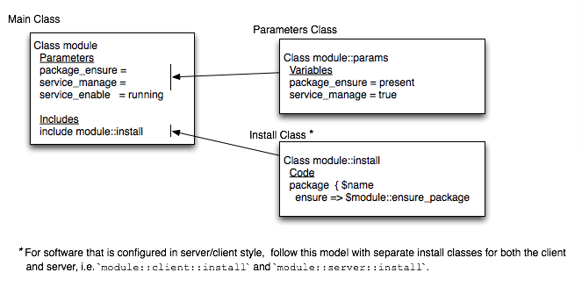
Class Structure

Slide 32
Puppet Relationships
Best practices recommend basing your requires, befores, and other ordering-related dependencies on classes rather than resources.
before
Causes a resource to be applied before the target resource.
require
Causes a resource to be applied after the target resource.
notify
Causes a resource to be applied before the target resource. The target resource will refresh if the notifying resource changes.
subscribe
Causes a resource to be applied after the target resource. The subscribing resource will refresh if the target resource changes.
# The two examples below create the # same ordering relationship: package { 'openssh-server': ensure => present, before => File['/etc/ssh/sshd_config'], } file { '/etc/ssh/sshd_config': ensure => file, mode => 600, source => 'puppet:///modules/sshd/sshd_config', require => Package['openssh-server'], } # The two examples below create the # same notification relationship: file { '/etc/ssh/sshd_config': ensure => file, mode => 600, source => 'puppet:///modules/sshd/sshd_config', notify => Service['sshd'], } service { 'sshd': ensure => running, enable => true, subscribe => File['/etc/ssh/sshd_config'], }

Slide 33
Puppet Resources
Are the fundamental unit for modeling system configurations.
Each resource describes some aspect of a system, like:
a service that must be running,
or a package that must be installed.
The block of code that describes a resource is called a resource declaration.
Have a type, a name and attributes that define the configuration of that resource.
Where Puppet shines, in relation to other tools, is that it empowers you to specify relationships between these resources and the modules they may be defined in.
# A resource declaration: file { '/etc/passwd': ensure => file, owner => 'root', group => 'root', mode => '0600', }
# Every resource has a type, # a title, and a set of attributes: type {'title': attribute => value, }

Slide 34
Puppet Resource Chaining
The chaining arrows accept the following types of operands on either side of the arrow:
Resource references, including multi-resource references
Resource declarations
Resource collectors
Operators
-> (ordering arrow)
Causes the resource on the left to be applied before the resource on the right. Written with a hyphen and a greater-than sign.
~> (notification arrow)
Causes the resource on the left to be applied first, and sends a refresh event to the resource on the right if the left resource changes. Written with a tilde and a greater-than sign.
# Chaining a Resource Declaration Package['ntp'] -> File['ntp.conf'] ~> Service['ntpd'] package { 'openssh-server': ensure => present, } -> file { '/etc/ssh/sshd_config': ensure => file, mode => 600, source => 'puppet:///modules/sshd/sshd_config', } ~> service { 'sshd': ensure => running, enable => true, }

Slide 35
Virtual Resource Declarations
A virtual resource declaration specifies a desired state for a resource without adding it to the catalog.
You can then add the resource to the catalog by realizing it elsewhere in your manifests.
This splits the work done by a normal resource declaration into two steps.
# Virtual Resource Declaration @user {'deploy': uid => 2004, comment => 'Deployment User', group => www-data, groups => ["enterprise"], tag => [deploy, web], } realize User['deploy'], User['zleslie']

Slide 36
Exported Resource Declarations
Exporting and collecting resources is an extension of Virtual Resources .
Puppet provides an experimental superset of virtual resources, using a similar syntax.
In addition to these resources being virtual, they’re also “exported” to other hosts on your network.
The key syntactical difference between virtual and exported resources is that the special sigils
Virtual Resource: @ and <| |>
Exported Resource: @@ and <<| |>>
class nagios-target { @@nagios_host { $fqdn: ensure => present, alias => $hostname, address => $ipaddress, use => “generic-host”, } @@nagios_service { “check_ping_${hostname}”: check_command => “check_ping!100.0,20%!500.0,60%”, use => “generic-service”, host_name => “$fqdn”, notification_period => “24x7”, service_description => “${hostname}_check_ping” } } class nagios-monitor { package { [ nagios, nagios-plugins ]: ensure => installed, } service { nagios: ensure => running, enable => true, #subscribe => File[$nagios_cfgdir], require => Package[nagios], } # collect resources and populate /etc/nagios/nagios_*.cfg Nagios_host <<||>> Nagios_service <<||>> }

Slide 37
Organizing & Referencing Files
Use the source attribute to download file contents from the server.
By default, fileserver.conf isn’t necessary, provided that you only need to serve files from modules.
If you want to create additional fileserver mount points, you can do so in $confdir/fileserver.conf (or whatever is set in the fileserverconfig setting).
Use `puppet:/// URIs` to specify which file to fetch.
The final segment of the URL starts inside the files/ directory of the module.
If there are any extra subdirectories, they work like you’d expect.
# File Resource Declaration file {'/etc/apache2/httpd.conf': ensure => file, source => 'puppet:///modules/apache/httpd.conf', }

Slide 38
Puppet Templates
Are documents that contain a mixture of static and dynamic content.
Maintain one source document that can be rendered into any number of final documents.
These flat files can contain Embedded Ruby (ERB), which variables can be set in the class or node level.
Use the template function to create a string by rendering a template.
Use the content attribute to fill file contents with a string.
It wouldn’t work with the source attribute, which expects a URL rather than the actual content for a file.
Template files are referenced as:
`modulename/filename.erb`
Variables from other scopes can be accessed with the `scope.lookupvar` method, which takes a long variable name without the $ prefix.
scope.lookupvar('apache::user')
# $confdir/modules/apache/templates/vhost.erb # file managed by puppet <VirtualHost<% ports.each do |port| -%> <%= port %><% end -%>> ServerName <%= name %> <% aliases.each do |serveralias| -%> ServerAlias <%= serveralias %> <% end -%> DocumentRoot <%= documentroot %> LogLevel warn ErrorLog <%= wwwroot %>/<%= name %>/logs/error.log CustomLog <%= wwwroot %>/<%= name %>/logs/access.log "<%= accesslog_format %>“ Include <%= wwwroot %>/<%= name %>/conf/*.conf <% if cgipath -%> ScriptAlias /cgi-bin/ <%= cgipath %> <Directory <%= cgipath %>> Options +ExecCGI AddHandler cgi-script .cgi </Directory> <% end -%> ServerSignature Off </VirtualHost>
# File Resource Declaration file {'/etc/apache2/sites/wordpress.conf': ensure => file, content => template('apache/vhost.erb'), }
Notes:
Supporting Notes:
Note that the path to the template doesn’t use the same semantics as the path in a puppet:///URL (which starts with modules). On behalf of PuppetLabs, “they wish to say sorry about the inconsistency.”
Templates: <MODULE NAME>/<FILENAME INSIDE TEMPLATES DIRECTORY>
Files: modules/<MODULE NAME>/<FILENAME INSIDE FILES DIRECTORY>

Slide 39
ERB Templating Language
Puppet doesn’t have its own templating language.
It uses ERB, a common Ruby-based template language.
Since tags can contain any Ruby code, it’s possible for templates to get pretty complicated.
Recommend keeping templates as simple as possible.
All of the variables visible in the current scope are available as Ruby instance variables.
@fqdn, @memoryfree, @operatingsystem, etc.
This style of reference works identically to using short (local) variable names in a Puppet manifest: @fqdn is exactly equivalent to $fqdn.
Puppet passes an object named scope to the template.
This contains all of the currently set variables, as well as some other data (including functions), and provides some methods for accessing them.
You can use the scope object’s lookupvar method to find any variable, in any scope.
<%= scope.lookupvar('apache::user') %>
<%= scope.lookupvar('::domain') %>
ERB Syntax
Non-Printing Tags
<% document = "" %>
Printing an Expression
<%= sectionheader %> environment = <%= gitrevision[0,5] %>
Comments
<%# This comment will be ignored. %>
Suppressing Line Breaks and Leading Space
<%- document += thisline -%>
Notes:
Supporting Notes:
NPT: ERB tags are delimited by angle brackets with percent signs just inside.
PaE: The value you print can be a simple variable, or it can be an arbitrarily complicated Ruby expression
SLS: Trim leading space by putting a hyphen directly after the opening delimiter
SLB: Trim line breaks by putting a hyphen directly before the closing delimiter

Slide 40
Puppet Configuration Run Diagram
Puppet Master
Check Credentials
Agent
Send Facts
Returns “catalog”
Report Results
Notes:
Supporting Notes:
Puppet 2.6.x doesn’t report by default, 2.7.x by default does.

Slide 41
PuppetDB
Collects data generated by Puppet.
The most recent facts from every node
The most recent catalog for every node
Optionally, seven days (configurable) of event reports for every node
Enables advanced Puppet features, like:
Inventory service and exported resources,
Which can be the foundation for other applications that use Puppet’s data.
Dashboard queries the puppetdb for information on nodes.
puppet node status <NODE>
Interacts with node objects, which are used by Puppet to build a catalog.
A node object consists of the node's facts, environment, node parameters (exposed in the parser as top-scope variables), and classes.
Scaling PuppetDB
Since it will be a critical component of your Puppet deployment
Agent nodes will be unable to request catalogs if it goes down, you should make sure it:
runs on a robust and reliable server,
can handle your site’s load,
is resilient against failures.
Refer to the scaling recommendations.

Slide 42
Puppet Reporting and Logs
Puppet Dashboard
A web interface providing node classification and reporting features for Puppet,
An open source system configuration management tool.
Inventory Service
The inventory is a collection of node facts.
The inventory service is a retrieval, storage, and search API exposed to the network by the puppet master.
The inventory service backend (AKA the facts_terminus) is what the puppet master uses to store the inventory and do some of the heavy lifting of the inventory service.
Foreman
Leverages Puppet through a smart proxy service.
Manages every stage of the lifecycle of your physical or virtual servers. The Foreman provides comprehensive, auditable interaction facilities including a web frontend and robust, RESTful API.
Tagmail, etc
Your puppet master server can send targeted emails to different admin users whenever certain resources are changed.
Notes:
Supporting Notes:
Puppet dependency was removed from Foreman core, so all Puppet usage is in the smart proxy only. This will make it optional for people who don't use Puppet, plus avoid conflicts when loading Puppet as a library. In addition, if puppetmaster is not on the same server as Foreman, Puppet no longer needs to be installed there at all.
Here are the lists of ports used by Puppet and Puppet related applications, Puppet Master – 8140 (Eg: puppet:8140) Puppet Dashboard – 3000 (Eg: http://puppet:3000) MCollective - 61613

Slide 43
Puppet stand-alone Mode
Apply configurations with the `puppet apply` command.
Can run with a flag of –e to execute single classes.
Configuration is stored locally on the host.
Catalogs are compiled locally and applied immediately.
Often run using a scheduled task or cron job.
[root@agent ~]# puppet apply -l /tmp/manifest.log manifest.pp
[root@agent ~]# puppet apply --modulepath=/root/dev/modules -e "include ntpd::server"
[root@agent ~]# puppet apply --catalog catalog.json

Slide 44
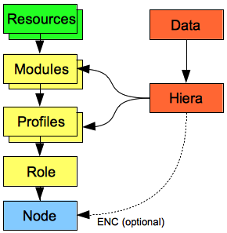
A Layer of abstraction
Reduces the complexity of configuration at a node level
Real-world terminology of roles improves “at-a-glance” visibility of what a server does
Definition of logical technology stacks (profiles) gives greater flexibility for edge cases
Profiles provide an area to add cross-module functionality such as resource chaining
Modules can be granular and secular and tied together in profiles, thus reducing the need to edit modules directly
Reduces code duplication

Slide 45
External Node Classifier (ENC)
An arbitrary script or application which can tell Puppet which classes a node should have.
Written using YAML.
Run as an executable that can be called by puppet master;
Can replace or work in concert with the node definitions in the main site manifest (site.pp).
The classes declared in each source are effectively merged.
Should classify a node to it’s role and nothing else.
Can declare classes, assign top-scope variables, and set an environment.
Puppet will also autoload any classes declared by an optional external node classifier.
It doesn’t have to be written in Ruby. Its only argument is the name of the node to be classified, and it returns a YAML document describing the node.
Must return either a YAML hash or nothing. This hash may contain classes, parameters, and environment keys, and must contain at least either classes or parameters.
ENCs should exit with an exit code of 0 when functioning normally,
May exit with a non-zero exit code if you wish puppet master to behave as though the requested node was not found.
# /etc/puppet/puppet.conf [master] node_terminus = exec external_nodes = /usr/local/bin/puppet_node_classifier
# /usr/local/bin/ntp --- classes: common: puppet: ntp: ntpserver: 0.pool.ntp.org aptsetup: additional_apt_repos: - deb localrepo.example.com/ubuntu lucid production - deb localrepo.example.com/ubuntu lucid vendor parameters: ntp_servers: - 0.pool.ntp.org - ntp.example.com mail_server: mail.example.com iburst: true environment: production
Notes:
Supporting Notes:
Configure the puppet master’s node_terminus. this setting takes effect where the catalog is compiled; on the puppet master server when using an agent/master arrangement, and on the node itself when using puppet apply. The default node terminus is plain, which returns an empty node object; the exec terminus calls an ENC script to determine what should go in the node object.
In Puppet 2.7 and earlier, ENC-set environments are not authoritative, and using them results in nodes using a mixture of two environments — the ENC environment wins during compilation, and the agent environment wins during file downloads. If you need to centrally control your nodes environments, you should upgrade to Puppet 3 as soon as is practical.
As a temporary workaround, you can manage nodes’ puppet.conf files with a template and set the environment based on the ENC’s value; this will allow nodes to use a consistent environment on their second (and subsequent) Puppet runs.
Another type of node terminus such as LDAP could be used.
Puppet 0.23.0 through 2.6.4
As above, with the following exception:
Classes - If present, the value of classes must be an array of class names. Parameterized classes cannot be used with an ENC.

Slide 46
What is Hiera?
A key/value lookup tool for configuration data, built to make Puppet better and let you set node-specific data without repeating yourself.
Makes Puppet better by keeping site-specific data out of your manifests.
Puppet classes can request whatever data they need, and your Hiera data will act like a site-wide config file.
This makes it:
Easier to configure your own nodes:
default data with multiple levels of overrides is finally easy.
Easier to re-use public Puppet modules:
don’t edit the code, just put the necessary data in Hiera.
Easier to publish your own modules for collaboration:
no need to worry about cleaning out your data before showing it around, and no more clashing variable names.
With Hiera, you can:
Write common data for most nodes
Override some values for machines located at a particular facility…
…and override some of those values for one or two unique nodes.
Puppet expects to find the hiera.yaml file at $confdir/hiera.yaml
# YAML --- apache-packages: - apache2 - apache2-common - apache2-utils apache-service: apache2 hosts_entry: “sandbox.%{fqdn}“ sshd_settings: root_allowed: “no“ sshd_settings: {root_allowed: "no", password_allowed: "yes"} sshd_settings: {root_allowed: no, password_allowed: yes} # JSON { "apache-packages" : [ "apache2", "apache2-common", "apache2-utils“ ], "hosts_entry" : "sandbox.%{fqdn}", "sshd_settings" : { "root_allowed" : "no", "password_allowed" : "no“ } }
Notes:
Examples:
#array #string #interpolated facter variable #hash #alternate hash notation # to return "true" or "false“
Supporting Notes:

Slide 47
Hiera Variables
Inserting
Passing
Can only interpolate variables whose values are strings.
Numbers from Puppet are also passed as strings and can be used safely.
Cannot interpolate an individual element of any array or hash, even if that element’s value is a string.
In YAML files:
Any string containing an interpolation token must be quoted in order to comply with the YAML spec.
Variables can come from a variety of sources, depending on how Hiera is invoked.
Puppet
Hiera automatically receives all of Puppet’s current variables. This includes facts and built-in variables, as well as local variables from the current scope.
Command Line
When called from the command line, Hiera defaults to having no variables available. You can specify individual variables, or a file or service from which to obtain a complete “scope” of variables.
Ruby
When calling Hiera from Ruby code, you can pass in a complete “scope” of variables as the third argument to the #lookup method.

Slide 48
Lookup Variables in HiERA
hiera
Standard priority lookup.
Gets the most specific value for a given key.
This can retrieve values of any data type (strings, arrays, hashes) from Hiera.
hiera_array
Uses an array merge lookup.
Gets all of the string or array values in the hierarchy for a given key, then flattens them into a single array of unique values.
hiera_hash
Uses a hash merge lookup.
Expects every value in the hierarchy for a given key to be a hash, and merges the top-level keys in each hash into a single hash.
Note that this does not do a deep-merge in the case of nested structures.
$ hiera ntp::servers ::fqdn=kermit.example.com $ hiera vmwaretools::working_dir osfamily=RedHat /opt/vmware $ hiera vmwaretools::working_dir osfamily=Debian /usr/local/vmware $ hiera vmwaretools::version 8.6.5-621624 $ hiera classes virtual=vmware vmwaretools # Get the structured data: $proxies = hiera('proxies') # Index into the structure: $use_ip = $proxies[1]['ipaddress'] # will be 192.168.22.28

Slide 49


Wait, When you said Puppet, I thought you Meant…
** Beaker and all Muppet characters are owned solely by, The Walt Disney Company.

Slide 50
Live Demo
Example:
Class to Manage User Folder
Determine User
Exists
Permissions
Group
Authorized Keys
Resources
Links
Directories
Files
Link to Github to download:
Generic User Profile Repo
VirtualBox w/ Puppet
Notes:
facter -p
facter osfamily operatingsystem
puppet describe <resource type> { puppet describe service | less }
puppet resource <type> <optional> { puppet resource file /etc/ }
puppet help <subcommand> <action> { puppet help apply }
puppet man <action>
puppet doc [-all] <file-spec>
puppet master --configprint modulepath
usermod –d /root/abernstein abernstein
grep 'abernstein' /etc/passwd
id abernstein
puppet apply --verbose user-abernstein.pp --noop

Slide 51
What Other Configuration Management Systems are out There?
Chef
Relies on reusable definitions known as cookbooks and recipes.
Written using the Ruby programming language.
Cookbooks and recipes automate common infrastructure tasks. Their definitions describe what your infrastructure consists of and how each part of your infrastructure should be deployed, configured and managed.
Chef applies those definitions to servers to produce an automated infrastructure.
Why Chef Should Manage Deploying Your Application
CFEngine
IT infrastructure automation framework
Helps IT organization manage and understand IT infrastructure throughout its lifecycle.
Takes systems from Build to Deploy, Manage and Audit.
Check out some of the online Resources

Slide 52
What Else is Out There?
AnsibleWorks
A radically simple IT orchestration engine.
Application Deployment
Configuration Management
Continuous Delivery
Avoid writing scripts or custom code to deploy and update your applications.
Automate in a language that approaches plain English, using SSH.
Requires nothing more than a password or SSH key in order to start managing systems
Does so without installing any agent software.
Works with playbooks designed to be human-readable and are developed in a basic text language.
Playbooks are expressed in YAML format and have a minimum of syntax.
Bcfg2
Based on an operational model in which the specification can be used to validate and optionally change the state of clients.
Client's response to the specification can also be used to assess the completeness of the specification.
Using this feature, Bcfg2 provides an objective measure of how good a job an administrator has done in specifying the configuration of client systems.
Built to help administrators construct an accurate, comprehensive specification.
Designed from the ground up to support gentle reconciliation between the specification and current client states.
It is designed to gracefully cope with manual system modifications.
Getting Started

Slide 53
Contact Information
Thank you! Questions?
Need additional guidance or reference material?
Download or print a copy of our Core Types Cheat Sheet and Modules Cheat Sheet for fast reference when writing your first manifests.
Experienced Puppet users spend most of their time in the type reference and the language guide.
Get acquainted with them early!
Provide feel free to contact me at the following addresses.
m: abernstein@godaddy.com
gd_github: abernstein
twitter: @bernstein_aaron

Slide 54
Resources (Documentation)
Official Site
Download Learning Puppet VM
Learning Guide
Style Guide
Glossary
Modules Documentation
Puppet Patterns
Beginners Guide to Modules
Puppet 2.7.x Reference Manual
Writing Custom Types
Puppet Forge
PuppetLabs Github
Puppet Standard Module Initiative
Git Workflow and Puppet Environments
Why Puppet Should Manage Your Infrastructure
Mcollective
Scaling Recommendations

Slide 55
Resources (Presentations)
Slideshare - Puppetlabs
Slideshare - PuppetConf 2013
PuppetLabs - Roles/Profiles
Puppet and Windows
Getting Started with the Learning Puppet VM
What’s New and Awesome in Puppet Enterprise 3
Introduction to Mcollective
Troubleshooting the Puppet Enterprise Stack

